Slide 1
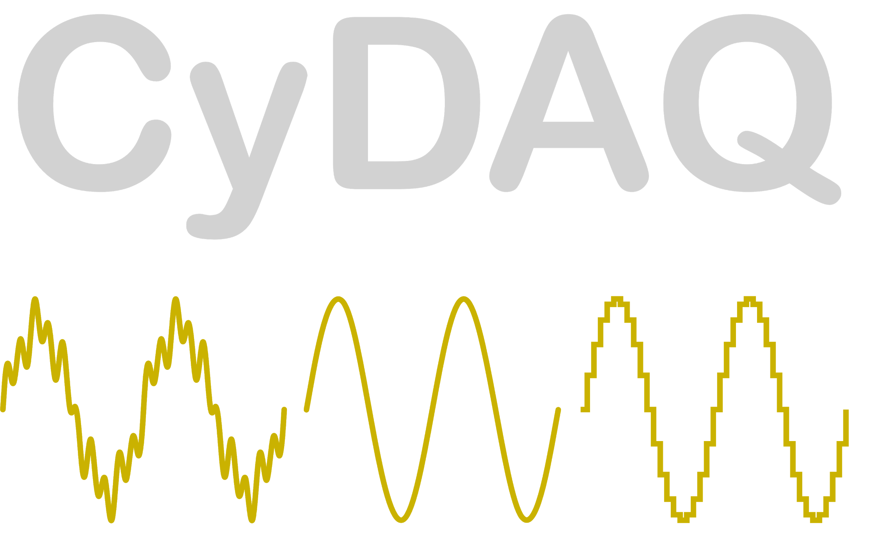
Introduction of Real-World Signals and Systems into ECpE DSP Laboratory Curriculum
Members:
Brady A. Max K.
Sam B. Emily L.
Mitchell H. Isaac R.
Team: SDDEC20-14
Advisor: Matthew Post
Client: Matthew Post Website: http://sddec20-14.sd.ece.iastate.edu/
Contact: sddec20-14@iastate.edu
Notes:
Ren

Slide 2
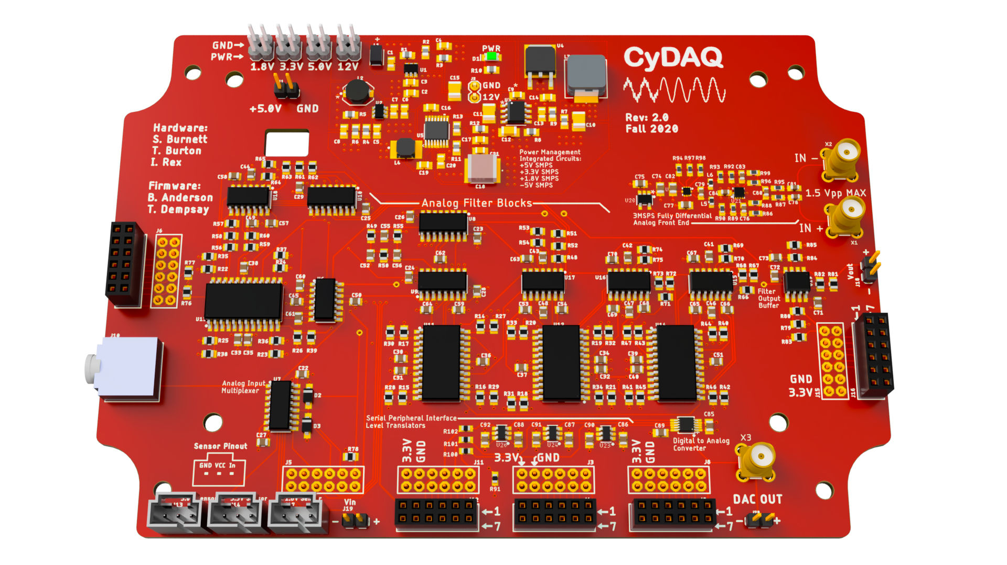
CyDAQ
CyDAQ is a hardware teaching platform designed for EE classes that contains onboard analog filters and interfaces for sampling data to a PC.
Our goal is to design labs and supplemental hardware that connect core concepts to real world hardware.
Notes:
Isaac

Slide 3
Targeted Curriculum (Short Term)
EE 224 (Signals & Systems I):
Intro to signal manipulation, LTI systems, Fourier analysis, and signal processing
Difficult, math heavy concepts
Lack of application and real-world context
Widely regarded as very difficult with little reward
EE 324 (Signals & Systems II):
Laplace & Z transform, digital and analog filters, control system analysis
Abstract concepts with little real world context
Design-without-purpose approach
Control system analysis–all math, no implementation
Notes:
Isaac

Slide 4
Conceptual Sketch
CyDAQ
Software/Firmware
Hardware
Labs
Embedded
Signal Routing
EE 224 & 324
Graphical Interface
Sampling
Learning Objectives
FPGA
Band-limiting
Real-World Application
Notes:
Ren

Slide 5
Project Goals
Create lab documents for EE 324 and EE 224
3 EE 224 Labs & Final Project
4 Labs for EE 324
Total Labs: 8
Final CyDAQ device revision
Expand sampling bandwidth with SPI differential ADC
Add SPI DAC to broaden application potential
Revise FPGA firmware to increase speed and reliability
Integrate DAC and differential ADC drivers
Complete redesign of the User Interface on MATLAB for intuitive use, and expandability
Notes:
Brady

Slide 6
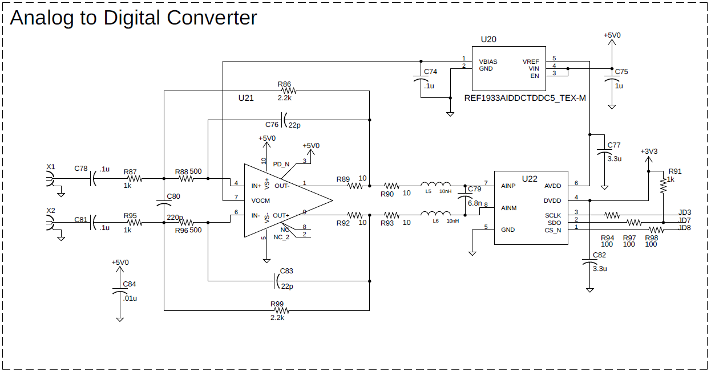
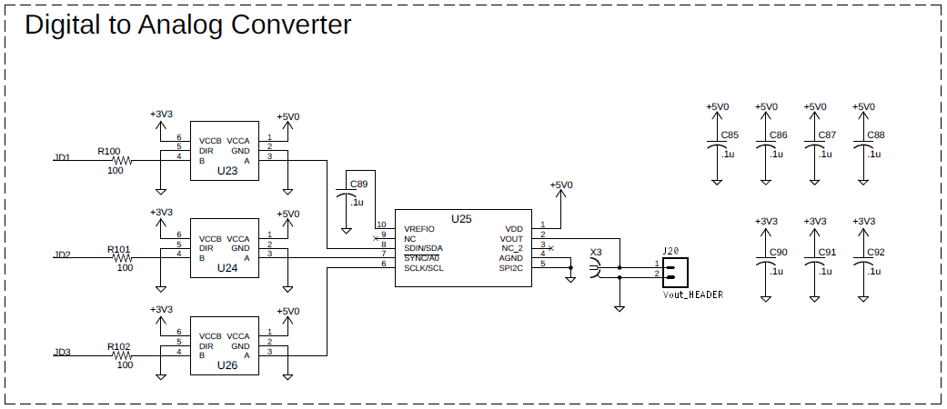
CyDAQ Hardware: Upgrades
Design Features:
Fully Differential Analog Front End with anti-aliasing filter and analog to digital converter
Digital to Analog Converter with 16 bit 5Vpp Buffered output
PMOD with new circuits fully implemented for legacy models
Notes:
Sam

Slide 7
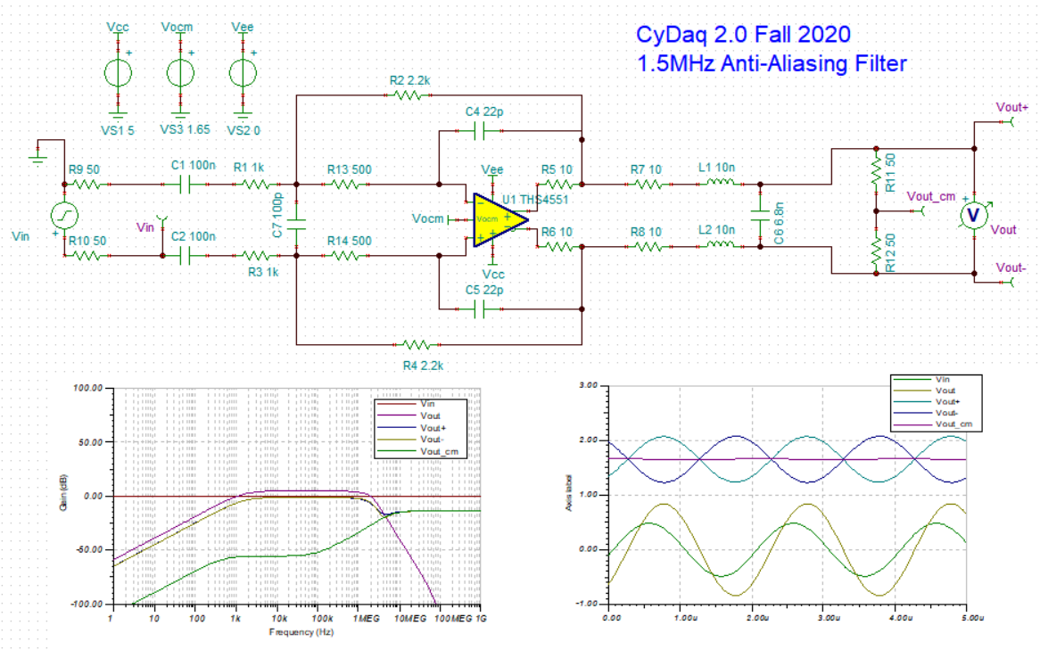
CyDAQ Hardware: Anti - Aliasing Filter for ADC
Design Features:
Multiple-feedback filter in series with differential LC low-pass filter for 60dB/decade roll-off
Fully differential, DC coupled to ADC, 50 Ohm termination match
FDA shares common mode with ADC measurement reference IC
Notes:
Sam

Slide 8
CyDAQ Hardware: ADC and DAC Implementation & Layout
Design Features:
Coaxial signal I/O
50MHz SPI communication
High-speed level translators
3MSPS Differential input
Active anti-aliasing filter
Buffered 5Vpp analog output
ADC
DAC
Notes:
Sam

Slide 9
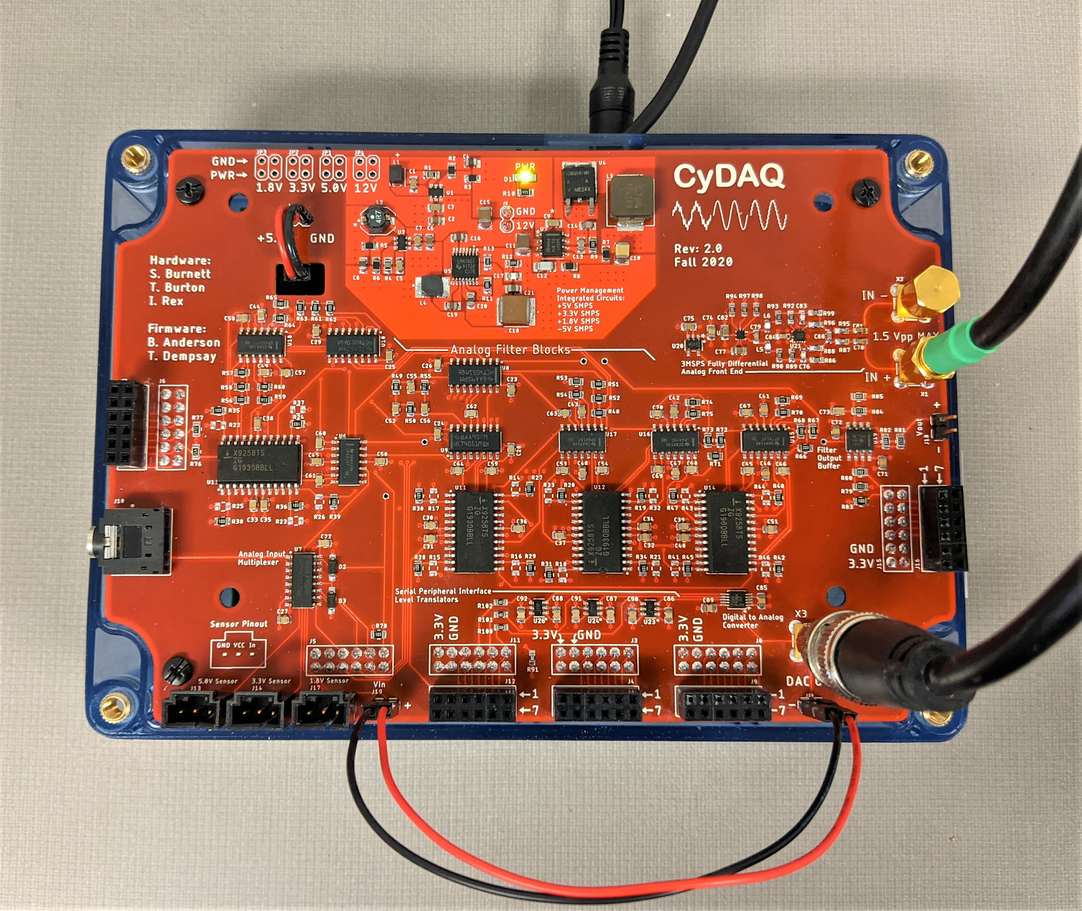
CyDAQ Hardware: Validation
Key Results:
Full build success
50MHz SPI confirmed
Vocm / Vref levels good
Waveform generation
Waveform sampling
Faculty Demonstration
Notes:
Sam

Slide 10
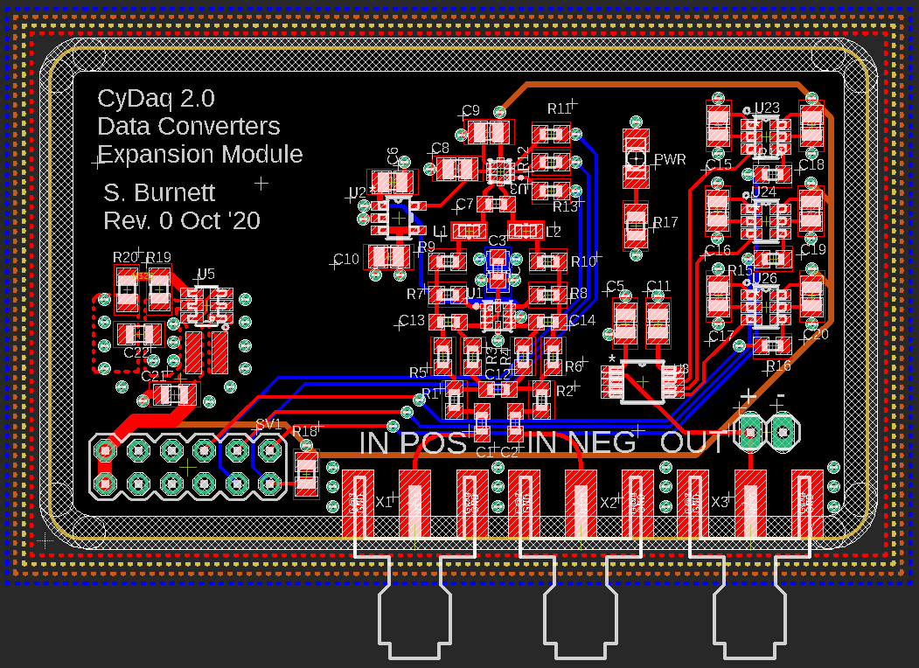
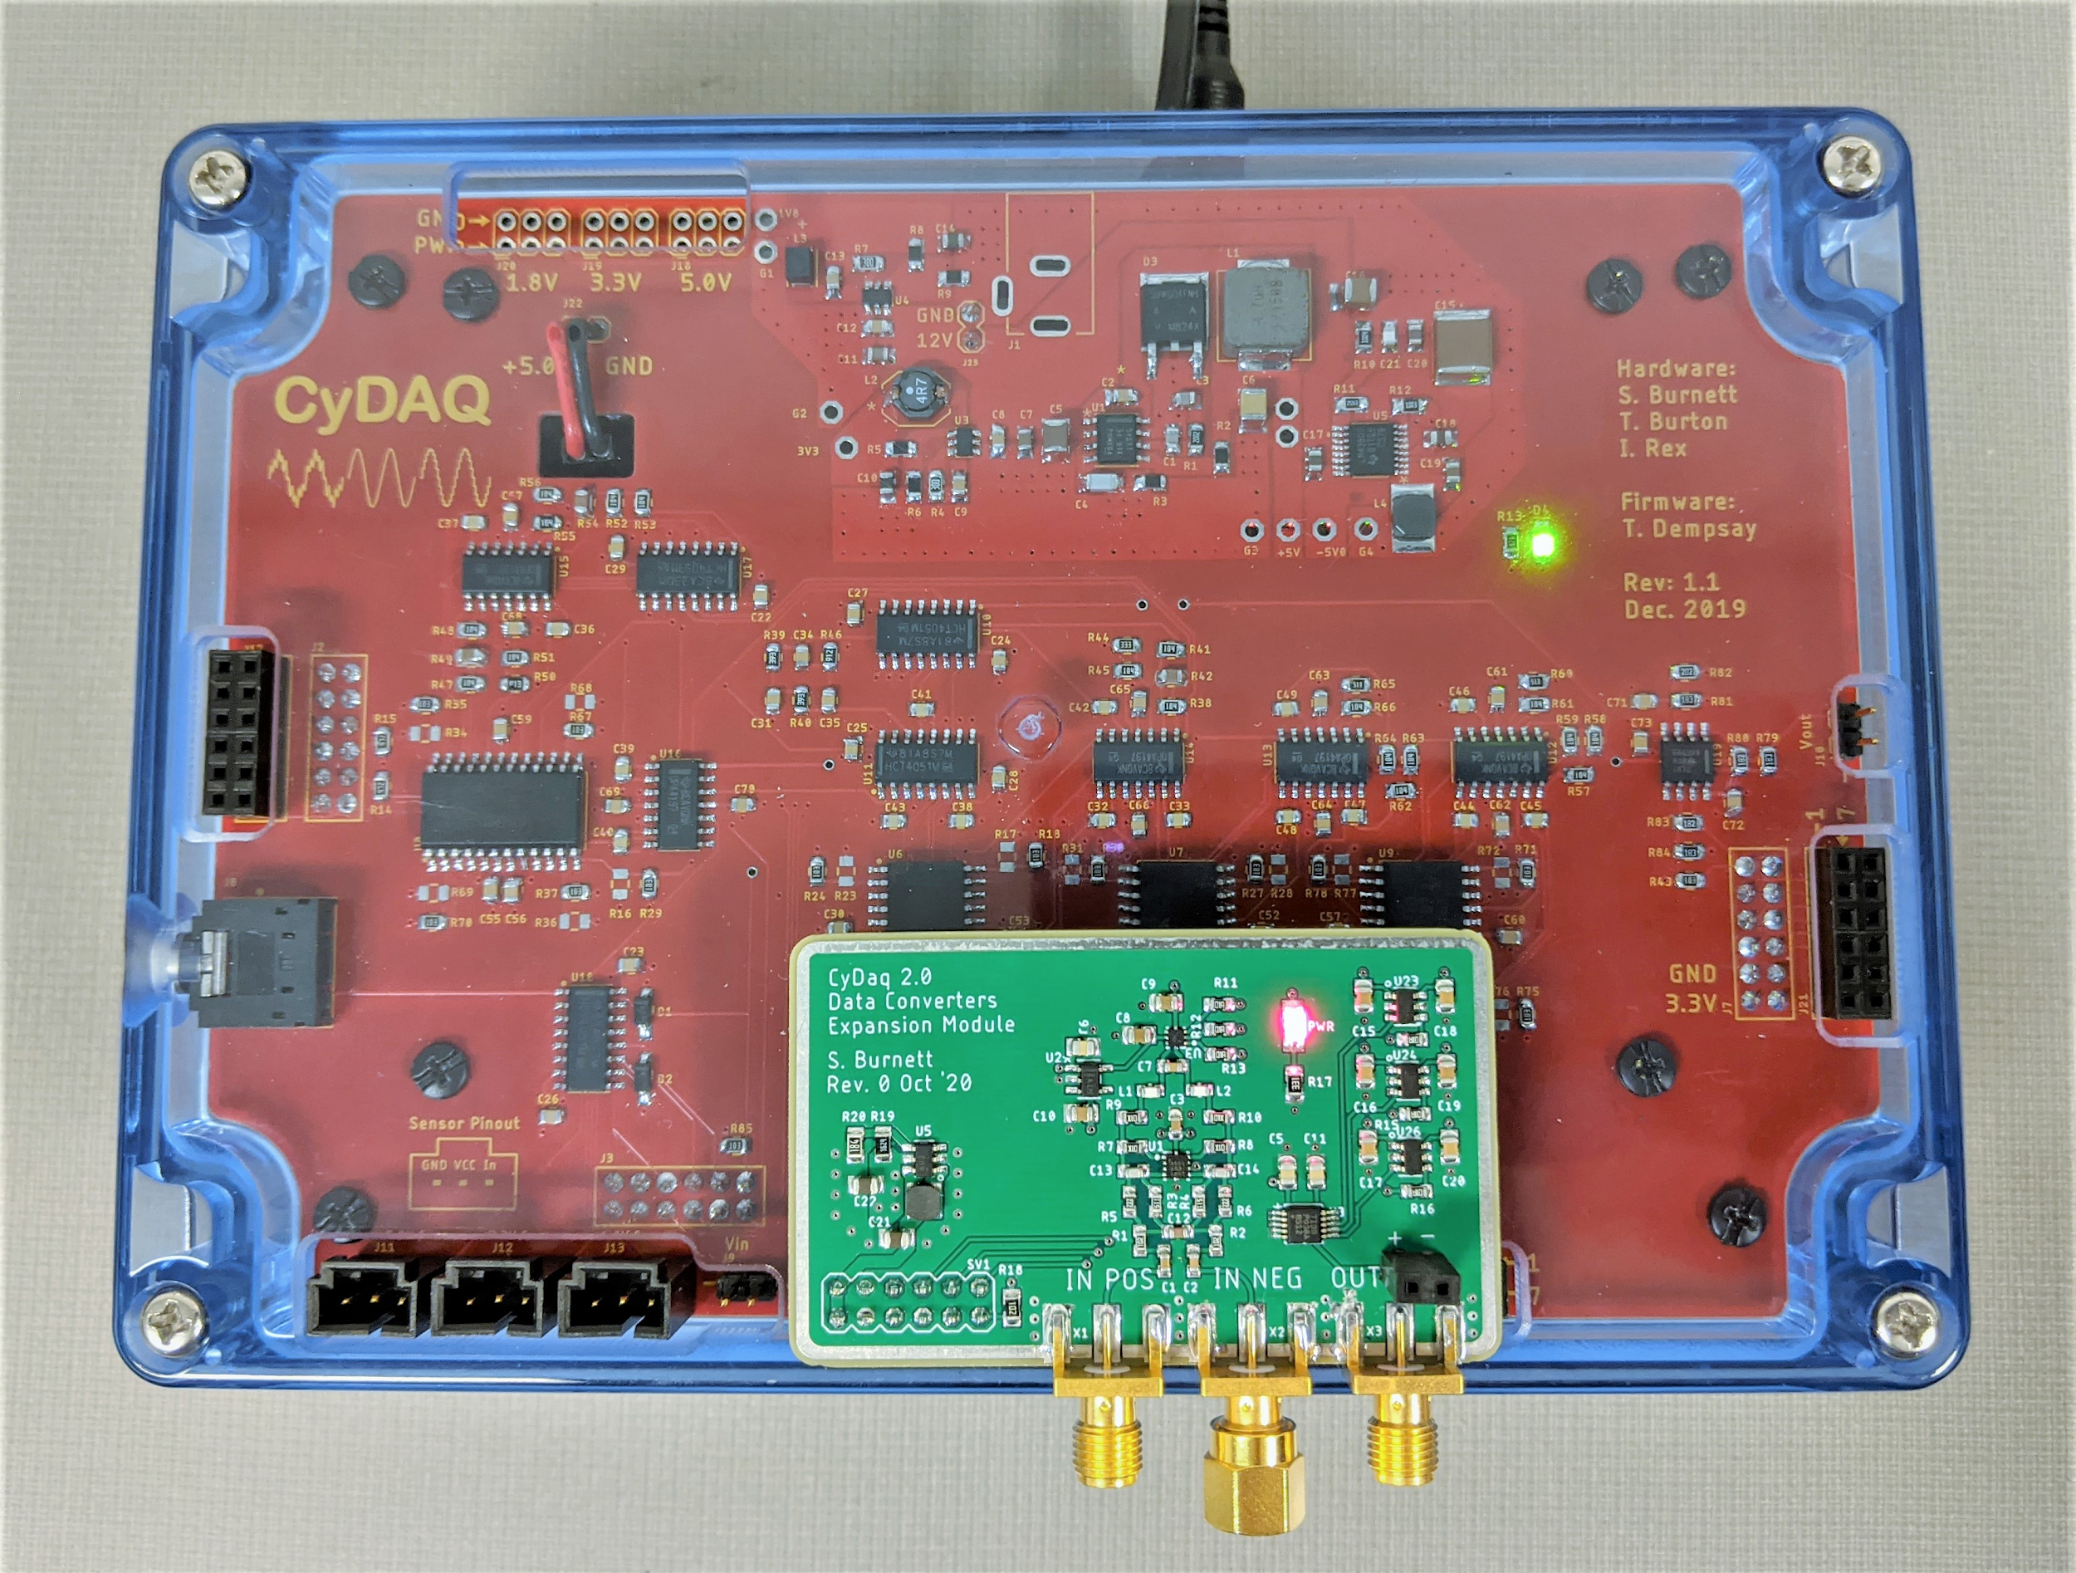
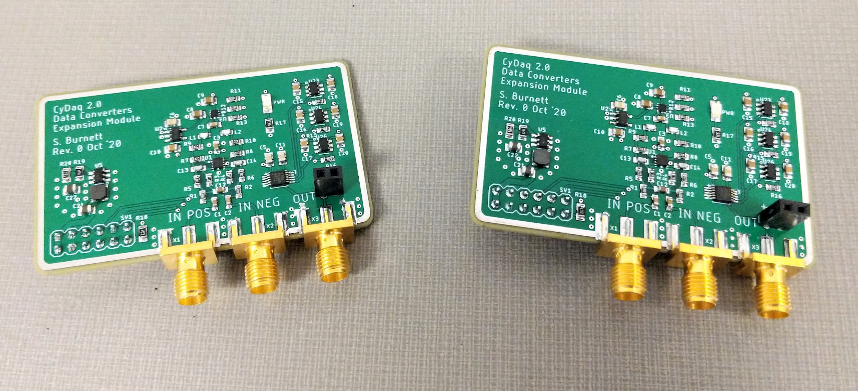
CyDAQ Hardware: PMOD Upgrade for Legacy Models
Features:
Mounts directly to revision 1 boards
Fully implements ADC and DAC circuitry
GPIO pinout matched to revision 2 firmware
Stand-alone power management
Notes:
Sam

Slide 11
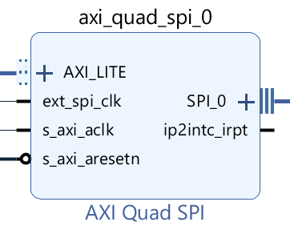
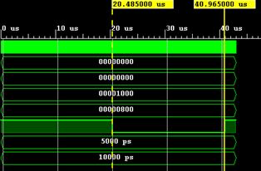
CyDAQ Software: Firmware & FPGA Design
FPGA Design:
SPI controller
Communicate with 16-bit DAC and 12-bit ADC
50MHz bus
PWM generator
Low-speed PWM for sensor & servo control
Custom core designed for CyDAQ
Notes:
Brady

Slide 12
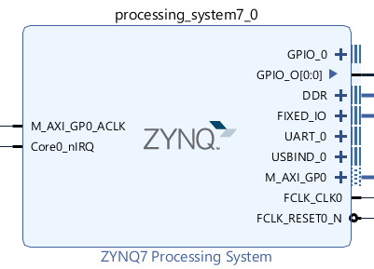
CyDAQ Software: Firmware & FPGA Design
Firmware:
Interrupt-based firmware
ISRs to process ADC and DAC operations
Passive loop to poll UART in background
SPI controller drivers
Configure SPI controller in FPGA fabric
Receive DAC datasets from lab PC
Drive DAC and read external ADC
Periodic with timers
Notes:
Brady

Slide 13
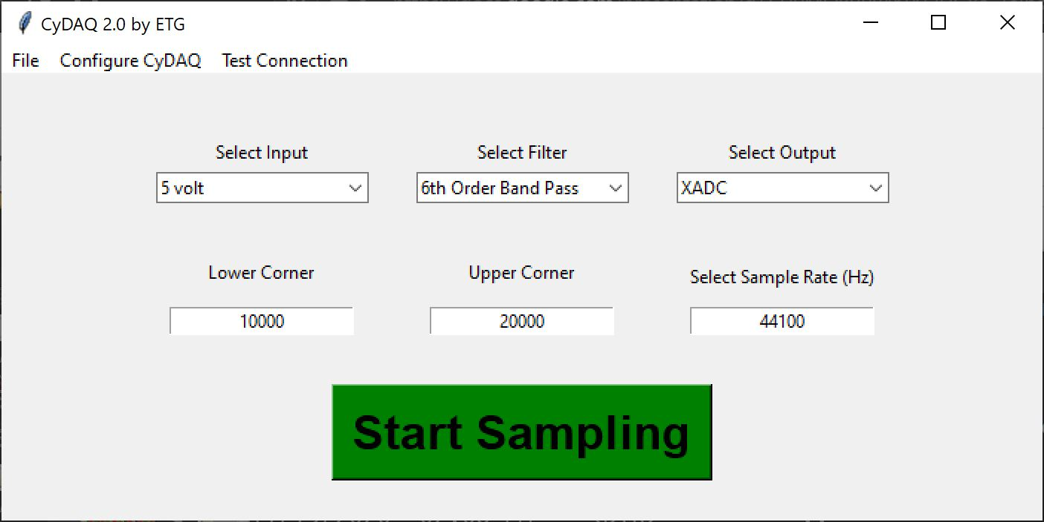
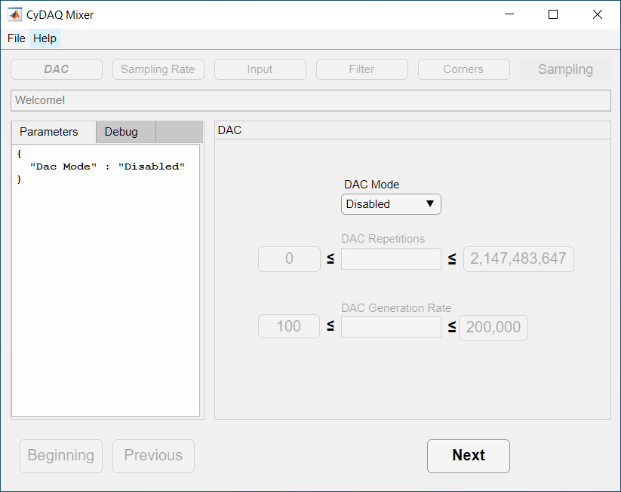
CyDAQ Software: PC User Interface
Front-end in MATLAB, back-end in PYTHON
Provides step-by-step direction on picking the right parameters for the CyDAQ to run on
User proof: Mixer will not allow you to configure the CyDAQ with an invalid set of parameters
Simple design for students using it for the first time
Notes:
Mitch
Completely redesigned the user interface that the students interact with in lab
MATLAB front-end and a PYTHON back-end for communicating with the CYDAQ over serial
intuituve design for students using it for the first time
Parameters adhere to the dependency requirements of the CYDAQ, so for instance you cannot have a digital output if the input is analog
Added support for generating signals with DAC

Slide 14
CyDAQ Labs
EE 224 Labs
Introduction to CyDAQ
Introduction to Noise Filtering
Image Restoration Lab
Heart Rate Project Lab
EE 324
Dynamic Systems Lab
Power Systems Design Lab
Control Systems I: Measuring Loop Response
Control Systems II: Controller Design

Slide 15
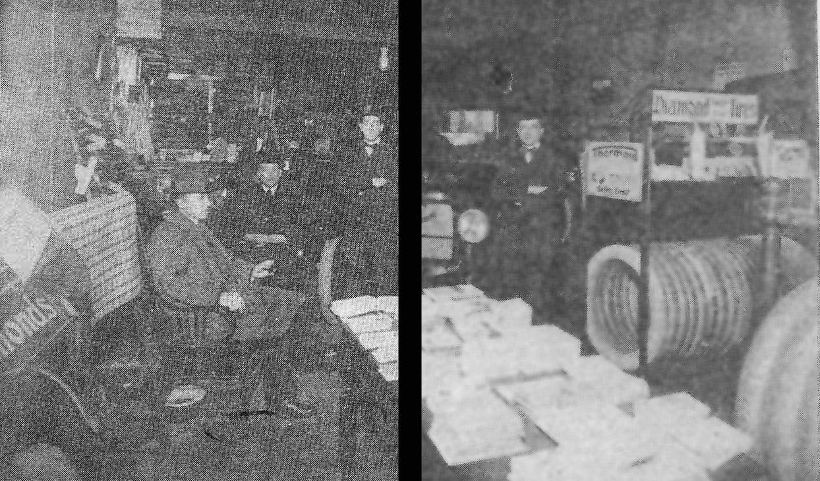
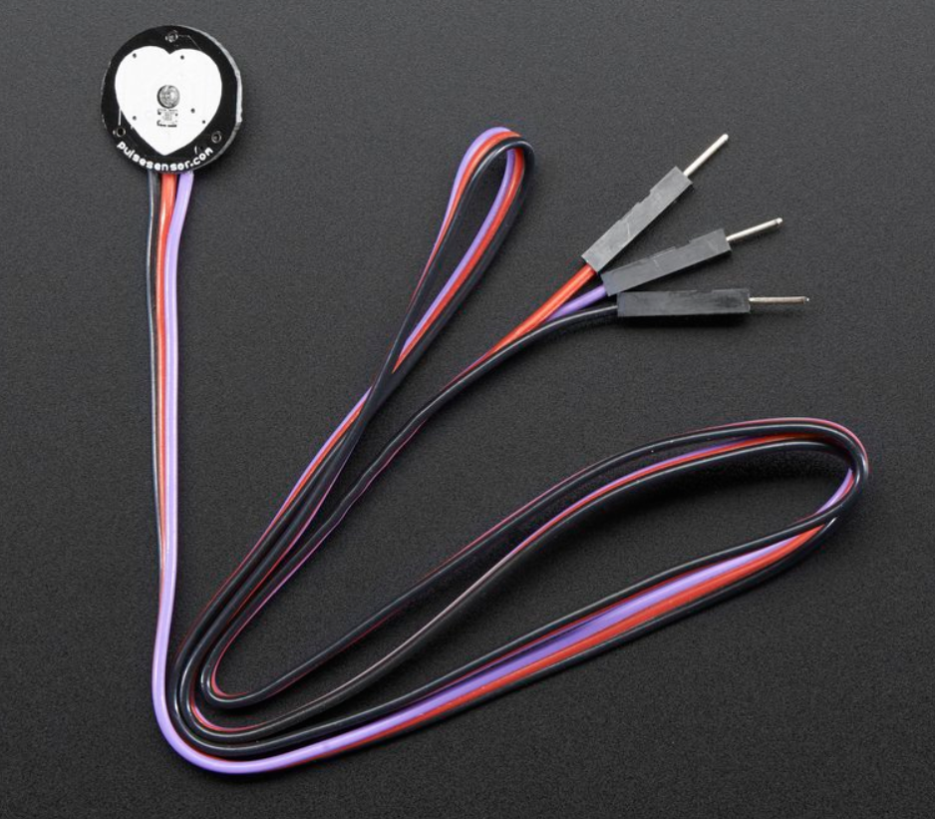
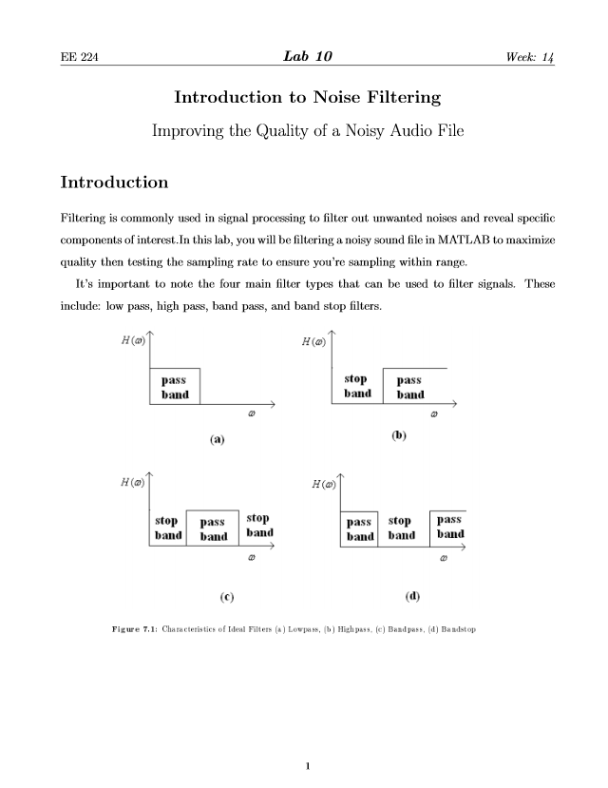
CyDAQ Labs
Labs:
Introduction to Noise Filtering
Filtering a noisy sound file
Identifying and implementing the correct filter using the CyDAQ
Heart Rate Project Lab
Open-ended design lab
Pulse Sensor input
Heart rate graph, BPM output
Notes:
Ren

Slide 16
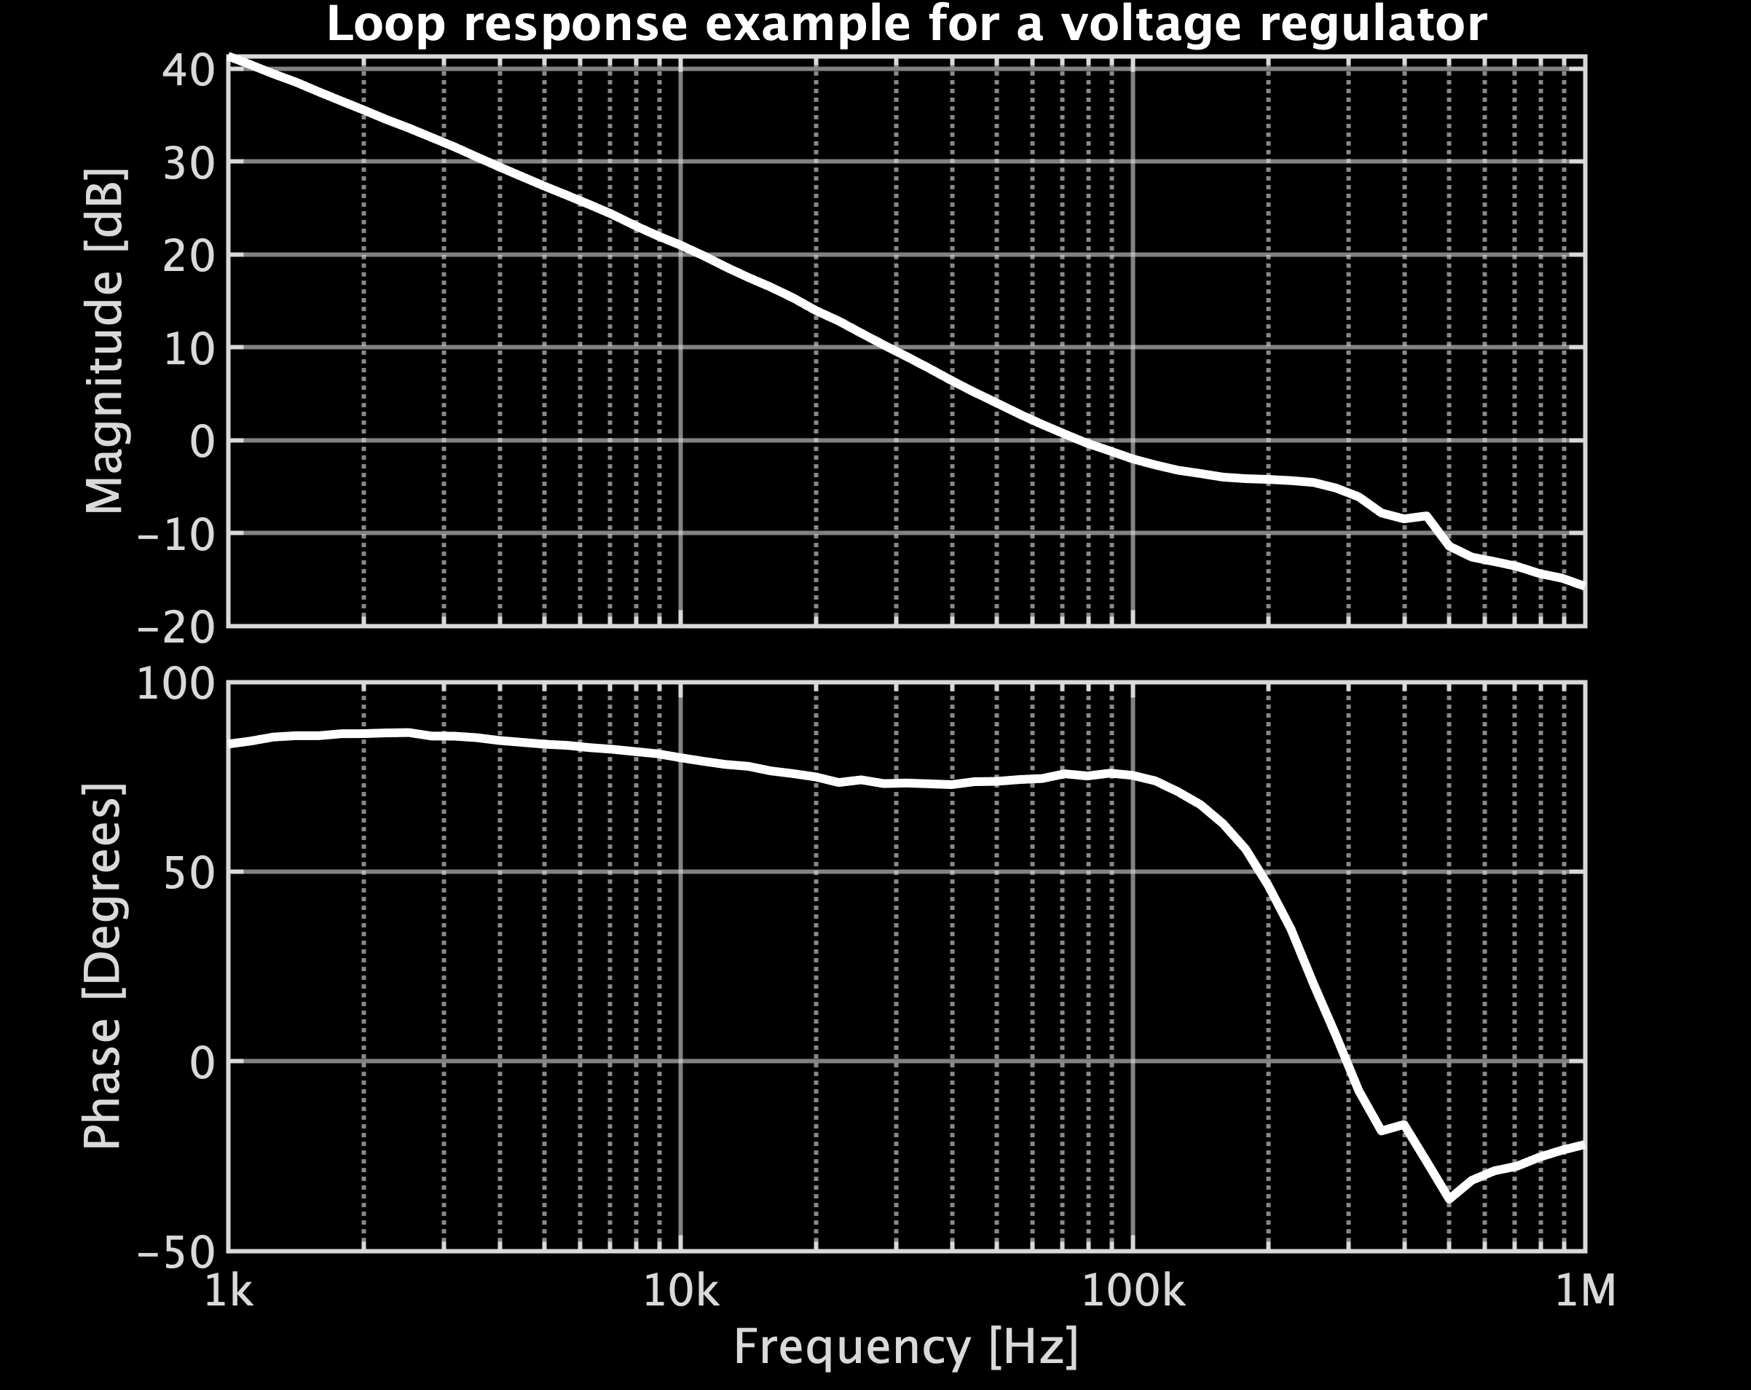
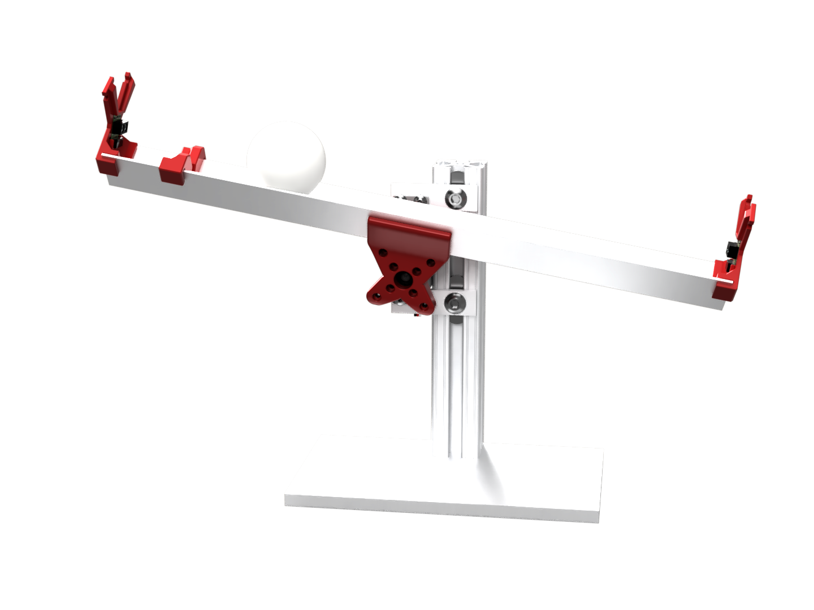
CyDAQ Labs
Labs:
Control Systems I: Measuring Loop Response
Parameter measurement
Power supply design
Control loop tuning
Application Notes
Control Systems II: Controller Design
System modeling and simulation
Tool-based controller design
Actual system implementation
Notes:
Isaac

Slide 17
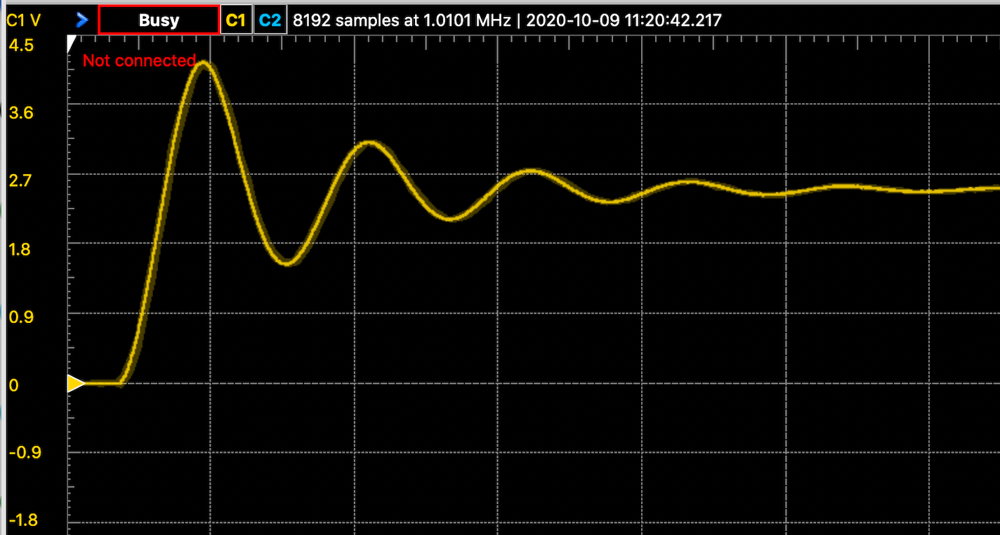
CyDAQ Labs
Labs:
Dynamic Systems Lab
Complete lab redesign to incorporate hands on, real world examples
Analysis of an LC circuit step response, comparing theoretical and practical results
Mechanical oscillator spring system utilizing CyDAQ to sample data
Deriving differential equations for lab models
Notes:
Max

Slide 18
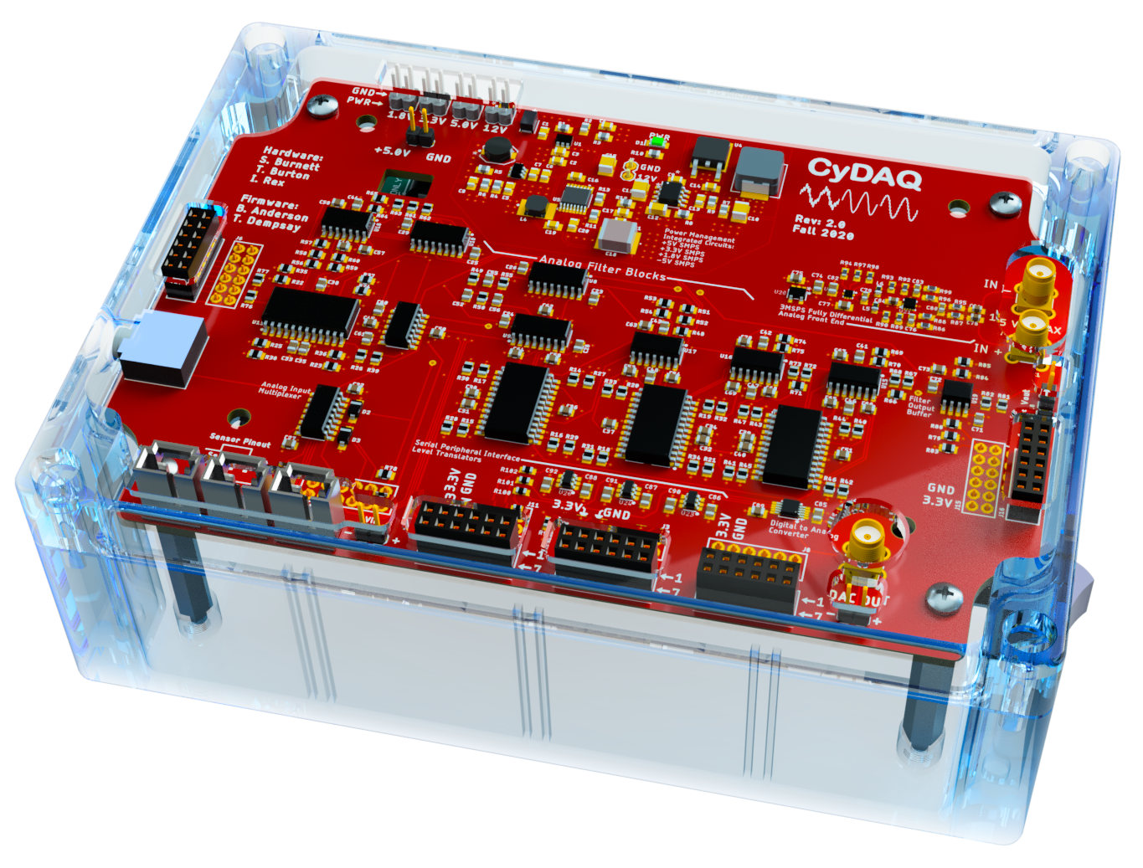
Summary:
Delivered hardware revision with functional upgrades fully implemented
Completed total redesign of front end GUI and backend firmware architecture
Produced several interactive labs connecting theory to practical application
Thank you for listening!
Questions?
Notes:
Max

